Slide 1

APPLIED SIGNAL PROCESSING LABORATORY
Paolo Allione s296500
Camolese Claudio s297378
Temmuz Sanli s298029

Slide 2
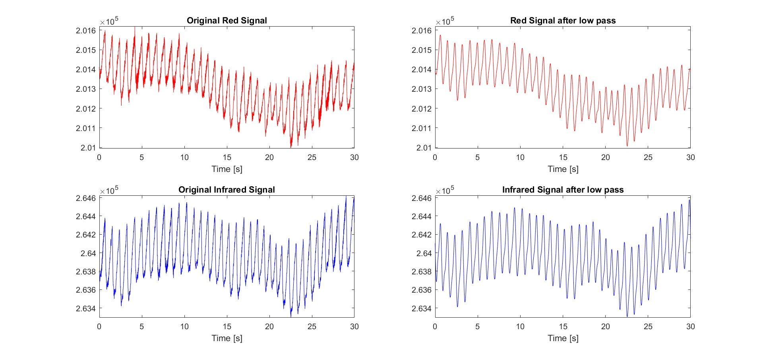

Slide 3
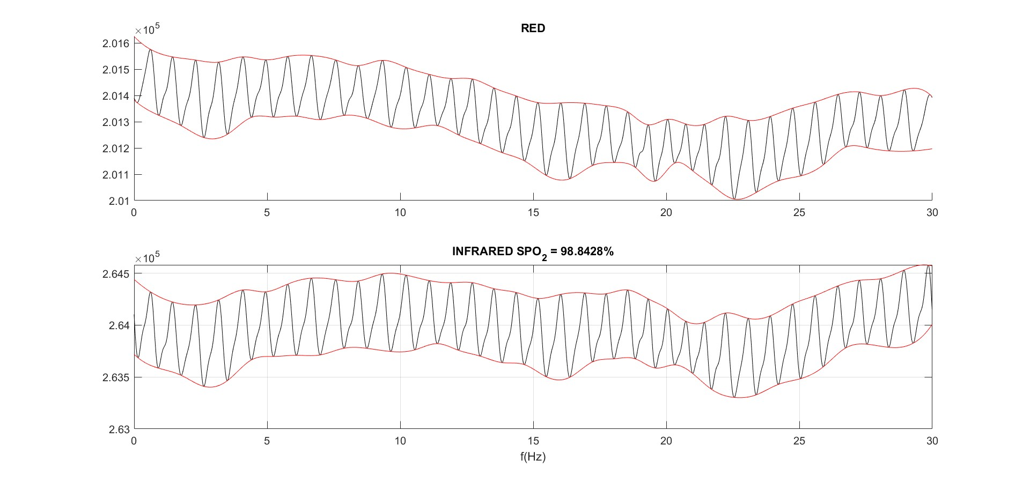

Slide 4
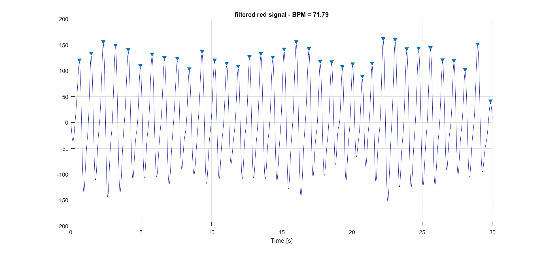

Slide 5
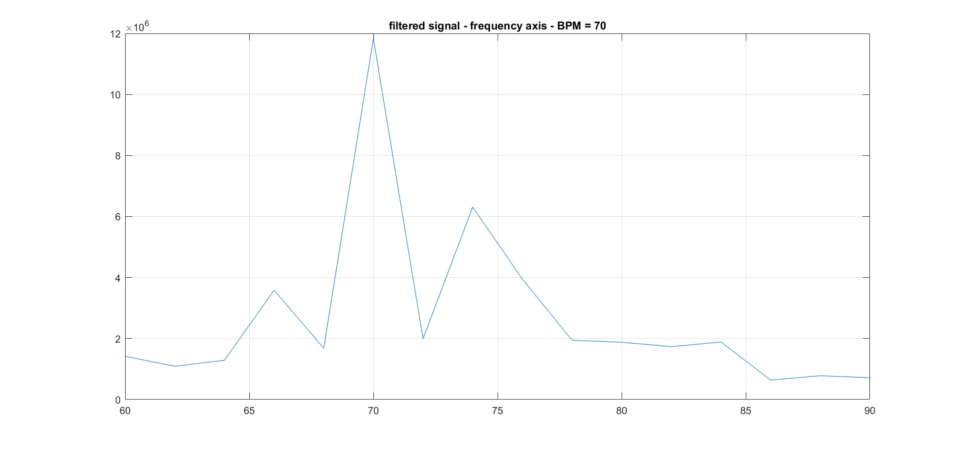

Slide 6
